Slide 1
Software Engineering &
Software as a Service
Prof. Debalina Nandy
Prof. Debalina Nandy

Slide 2
Objectives
Introduce SOA concepts.
Introduce a service-oriented software engineering process.
Overview some technologies underlying web services based on SOA.
Examine some steps for migrating legacy applications into web services.
Prof. Debalina Nandy

Slide 3
Outline
What is SOA?
Service-oriented software engineering
SOA under the hood
Legacy migration issues
Prof. Debalina Nandy

Slide 4
Service-oriented architectures
A means of developing distributed systems where the components are stand-alone services.
Services may execute on different computers from different service providers.
Standard protocols have been developed to support service communication and information exchange.
Prof. Debalina Nandy

Slide 5
Services or components?
A service can be defined as:
  A loosely-coupled, reusable software component that encapsulates discrete functionality which may be distributed and programmatically accessed. A web service is a service that is accessed using standard Internet and XML-based protocols.
A critical distinction between a service and a component as defined in component-based software engineering is that services are independent.
  Services do not have a ‘requires’ interface.
  Services rely on message-based communication with messages expressed in XML.
Prof. Debalina Nandy

Slide 6
Benefits of SOA
Services can be provided locally or outsourced to external providers.
Services are language-independent.
Investment in legacy systems can be preserved.
Inter-organizational computing is facilitated through simplified information exchange.
Prof. Debalina Nandy

Slide 7
SOA and Web Services
Service-oriented architecture is an architectural style
  Derived from the client-server architectural style.
  Clients (service consumers or requesters) and servers (service providers) connected by a service “bus”.
  Services defined using formal interfaces (contracts).
  Service bus supports point-to-point and messaging styles of communication.
  Support for system qualities, e.g., security and transaction management.
Web services
  Services provided in a SOA deployed over the web.
Prof. Debalina Nandy
Notes:
Open source software for SOA, IONA Technologies A-Trenaman-SOA.pdf

Slide 8
Key standards
SOAP (Simple Object Access Protocol)
  A message exchange standard that supports service communication.
WSDL (Web Service Definition Language)
  This standard allows a service interface and its bindings to be defined.
UDDI (Universal Description Discovery and Integration)
  Defines the components of a service specification that may be used to discover the existence of a service.
Prof. Debalina Nandy

Slide 9
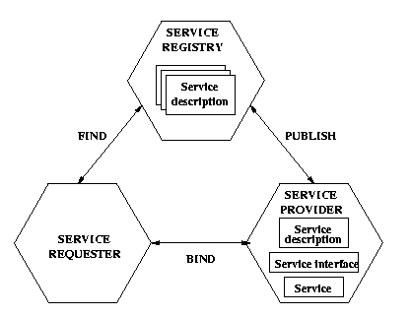
Service-oriented architecture
UDDI
SOAP
WSDL
Prof. Debalina Nandy

Slide 10
SOAP messages
SOAP is based on message exchanges
Messages are seen as envelops where the application encloses the data to be sent
A message has two main parts:
  header: which can be divided into blocks
  body: which can be divided into blocks
SOAP does not say what to do with the header and the body, it only states that the header is optional and the body is mandatory
Use of header and body, however, is implicit. The body is for application level data. The header is for infrastructure level data
SOAP Envelope
SOAP header
Header Block
SOAP Body
Body Block
Prof. Debalina Nandy

Slide 11
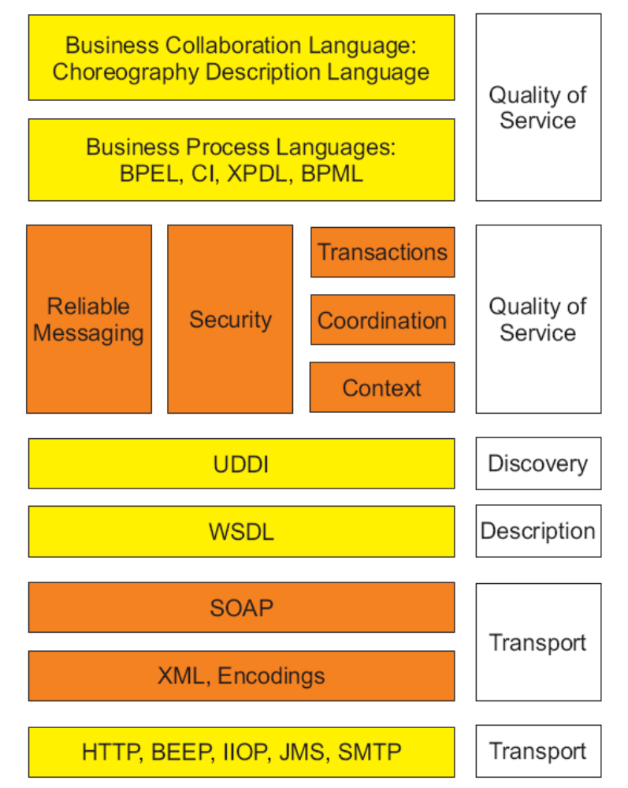
Emerging web services platform
Prof. Debalina Nandy

Slide 12
Outline
What is SOA?
Service-oriented software engineering
SOA under the hood
Legacy migration issues
Prof. Debalina Nandy

Slide 13
Service-oriented software engineering
Existing approaches to software engineering have to evolve to reflect the service-oriented approach to software development.
  Service engineering. The development of dependable, reusable services.
    Software development for reuse.
  Software development with services. The development of dependable software where services are the fundamental components
    Software development with reuse.
Prof. Debalina Nandy

Slide 14
Outline
What is SOA?
Service-oriented software engineering
SOA under the hood
Legacy migration issues
Prof. Debalina Nandy

Slide 15
Contents
Brief Background information
SaaS Architecture
Prof. Debalina Nandy

Slide 16
Intro to SaaS - Definition
Software as a service (SaaS) is a model of software delivery where the software company provides maintenance, daily technical operation, and support for the software provided to their client.
It assumes the software is delivered over the internet.
Software delivered to home consumers, small business, medium and large business
Prof. Debalina Nandy

Slide 17
Intro to SaaS
The web as a platform is the center point
Web-browser acting as a thin-client for accessing the software remotely across the internet.
Network-based access to, and management of, commercially available (i.e., not custom) software
application delivery that typically is closer to a one-to-many model (single instance, multi-tenant architecture) than to a one-to-one model, including architecture, pricing, partnering, and management characteristics
Prof. Debalina Nandy
Notes:
The web’s current success mostly thanks to the bandwidth technologies.
opening the doors for companies to do things they could not before
we had companies trying to do Saas like Corel w/ WordPerfect
Dumb terminals,
back to the mainframe
Not custom software
that would open the doors for trying to please everyone
custom software means things are more tightly coupled

Slide 18
SaaS - Pros
Stay focused on business processes
Change software to an Operating Expense instead of a Capital Purchase, making better accounting and budgeting sense.
Create a consistent application environment for all users
No concerns for cross platform support
Easy Access
Reduced piracy of your software
Lower Cost
  For an affordable monthly subscription
  Implementation fees are significantly lower
Continuous Technology Enhancements
Prof. Debalina Nandy
Notes:
Create a consistent application environment for all users through access to the same versions – compatibility –
Implementation fees are significantly lower than purchasing proprietary software and hardware.

Slide 19
SaaS - Cons
Initial time needed for licensing and agreements
  Trust, or the lack thereof, is the number one factor blocking the adoption of software as a service (SaaS).
  Centralized control
  Possible erosion of customer privacy
Absence of disconnected use
Prof. Debalina Nandy
Notes:
Another mitigating factor is need for disconnected use. Many users, such as traveling salespeople, need access to data while offline. Some apps have synchonization

Slide 20
SaaS Architecture
Fueled by
  Bandwidth technologies
  The cost of a PC has been reduced significantly with more powerful computing but the cost of application software has not followed
  Timely and expensive setup and maintenance costs
  Licensing issues for business are contributing significantly to the use of illegal software and piracy.
Prof. Debalina Nandy
Notes:
The bigger the hard drives the bigger the applications get
Cost of software has stayed the same or gotten higher
Even some small to medium companies are using pirated software cause they cannot afford it
I worked for a company that only installed products like huge Accounting packages as consultants. Made lots of cash due to long days to setup package

Slide 21
High-Level Architecture
There are three key differentiators that separate a well-designed SaaS application from a poorly designed one
  scalable
  multi-tenant-efficient
  configurable
Scaling the application - maximizing concurrency, and using application resources more efficiently
  i.e. optimizing locking duration, statelessness, sharing pooled resources such as threads and network connections, caching reference data, and partitioning large databases.
Prof. Debalina Nandy
Notes:
A well-designed SaaS application is scalable, multi-tenant-efficient, and configurable.

Slide 22
High-Level Architecture (con’t)
Multi-tenancy – important architectural shift from designing isolated, single-tenant applications
  One application instance must be able to accommodate users from multiple other companies at the same time
  All transparent to any of the users.
  This requires an architecture that maximizes the sharing of resources across tenants
  is still able to differentiate data belonging to different customers.
Prof. Debalina Nandy
Notes:
- may be the most significant paradigm shift that an architect accustomed to designing isolated, single-tenant applications has to make.
- when a user at one company accesses customer information by using a CRM application service, the application instance that the user connects to may be accommodating users from dozens, or even hundreds, of other companies

Slide 23
High-Level Architecture (con’t)
Configurable - a single application instance on a single server has to accommodate users from several different companies at once
  To customize the application for one customer will change the application for other customers as well.
Traditionally customizing an application would mean code changes
Each customer uses metadata to configure the way the application appears and behaves for its users.
Customers configuring applications must be simple and easy without incurring extra development or operation costs
Prof. Debalina Nandy
Notes:
a single application instance on a single server has to accommodate users from several different companies at once,
writing custom code to customize for the application for one end-user will change the application for other customers as well.
Instead of customizing the application in the traditional sense, each customer uses metadata to configure the way the application appears and behaves for its users.
The challenge for the SaaS architect is to ensure that the task of configuring applications is simple and easy for the customers, without incurring extra development or operation costs for each configuration.

